Slide 1






CLSTM: Deep Feature Based Speech Emotion Recognition Using the Hierarchical ConvLSTM Network

Slide 2

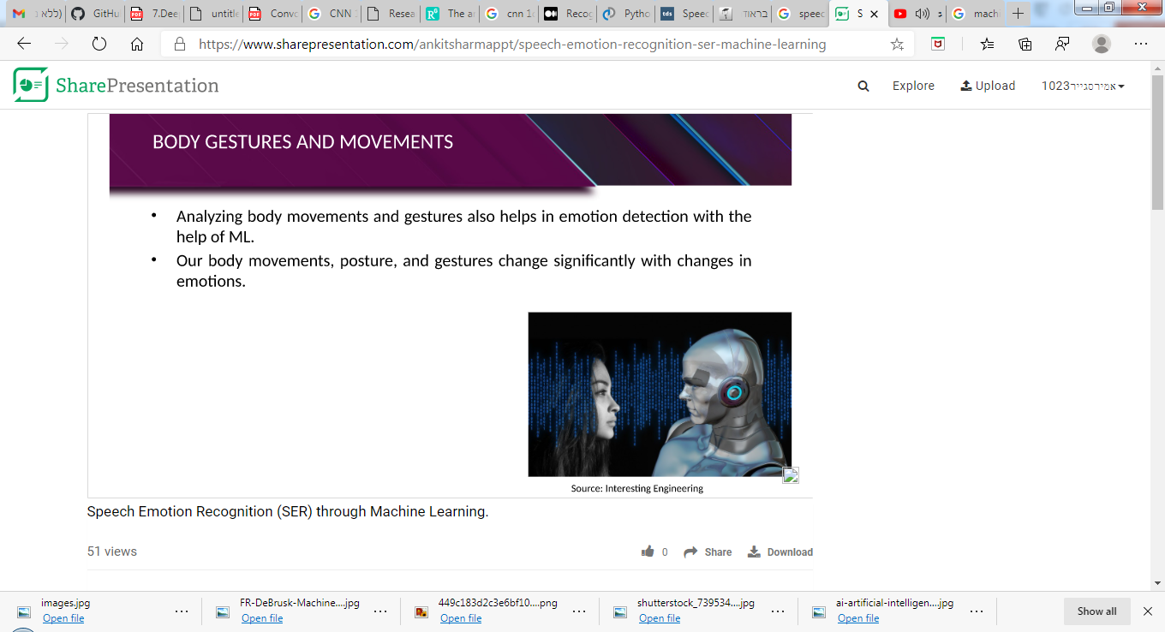
Problem statement
Speech Emotion Recognition system used to recognize the emotion from sound which are recorded by humans.
A Speech emotion recognition system is used to visualize convolutional neural network.

Slide 3

INTRODUCTION
Emotions are important part of understanding human interactions
Research is going into finding methods that can at the very least mimic human ability to recognise emotions displayed in the form of facial expressions, changes in tone while speaking, etc.
Speech Emotion Recognition (SER) is one of such fields. Using deep learning and machine learning algorithms, we aim to design an automatic emotion recognition system.

Slide 4
Project Milestones
Load the RAVDESS and TESS dataset
Save the dataset by using joblib library
Preprocess the data
Building the model
Train the model
Evaluate the model
Segment the sound
Filter the segmented sound using the model
Predict the segmented emotion as output

Slide 5
DATASET
The dataset is built using 5252 sounds
Ryerson Audio-Visual Database of Emotional Speech and Song (RAVDESS) dataset. contains 2452 files. The database contains 24 professional actors (12 female, 12 male), vocalizing two lexically-matched statements in a neutral North American accent , all file in wave form . Speech includes calm, happy, sad, angry, fearful, surprise, and disgust expressions.
Toronto emotional speech set (TESS) dataset. Has 2800 sound file voiced by two actresses , all file are in the form wave , Speech includes happy, sad, angry, fearful, surprise, and disgust expressions.

Slide 6
Preprocess the data
We used Librosa library to load the data
We used Mel-frequency cepstral coefficients (MFCC) to extract high frequency and low frequency information, the table shows classes the model wants to predict
Convert the data into matrix 5252*40
Standardization the data.
Save the data using joblib library to load the data again more faster
😂😉😋😒😭
 | Class | Emotion
 | 0 | Natural
 | 1 | calm
 | 2 | Happy
 | 3 | Sad
 | 4 | Angry
 | 5 | fearful
 | 6 | disgust
 | 7 | surprised

Slide 7


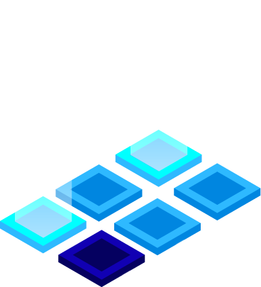



Building the model!
A CNN model generally consists of convolutional and pooling layers.
An efficient way to build neural network architectures is to use classic networks.
In our project the architecture we have used is Conv1-Activation-MaxPooling1D-Dropout-Dense-Flatten.

Slide 8
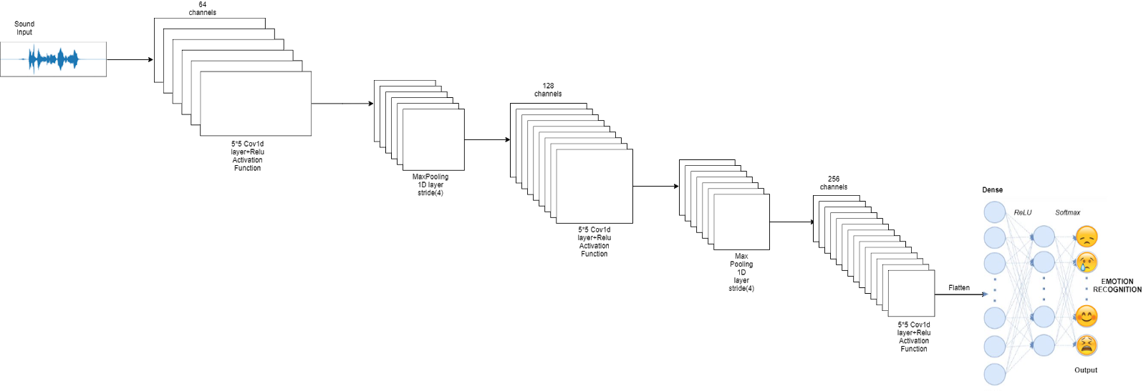
Model architecture

Slide 9
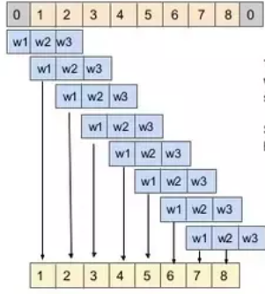
Convolution1D
A CNN works well for identifying simple patterns within your data which will then be used to form more complex patterns within higher layers. A 1D CNN is very effective when you expect to derive interesting features from shorter (fixed-length) segments of the overall data set and where the location of the feature within the segment is not of high relevance.
This applies well to the analysis of time sequences of sensor data (such as gyroscope or accelerometer data). It also applies to the analysis of any kind of signal data over a fixed-length period (such as audio signals).

Slide 10
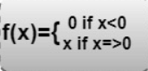
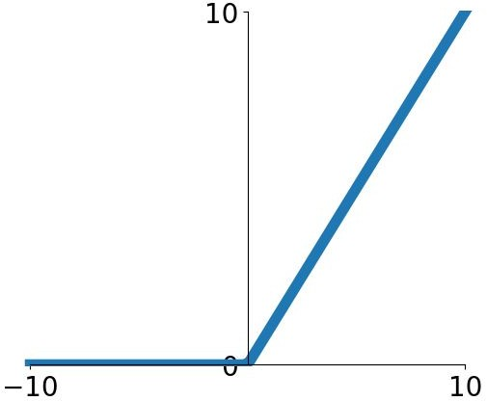
ReLu
ReLu is computed after the convolution and is a nonlinear activation function like tanh or sigmoid.
ReLu improve neural networks is by speeding up training

Slide 11
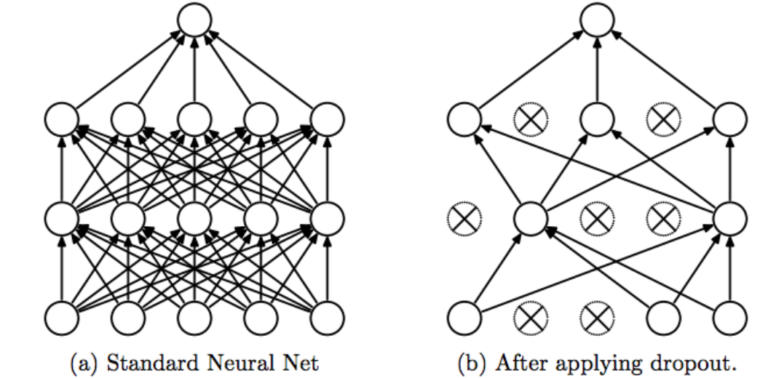
Dropout layer:
The Dropout layer randomly sets input units to 0 with a frequency of rate at each step during
training time, which helps prevent overfitting. Inputs not set to 0 are scaled up by 1/(1 - rate) such
that the sum over all inputs is unchanged

Slide 12
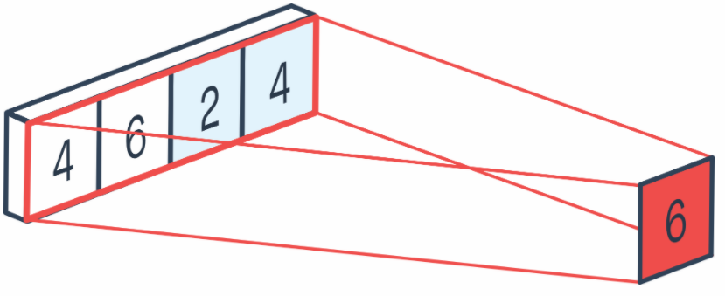
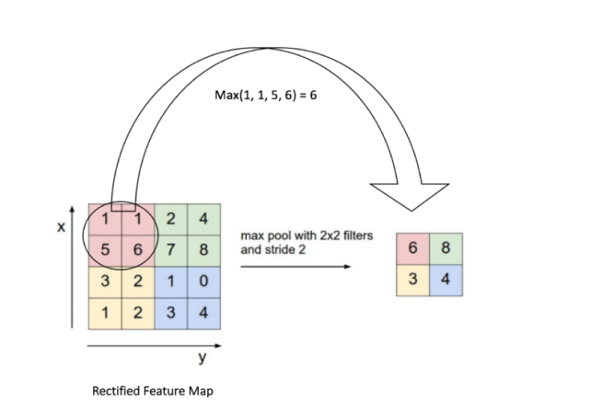
MaxPooling
A pooling layer is often used after a CNN layer in order to reduce the complexity of the output and prevent over fitting of the data.
Maximum pooling, or max pooling, is a pooling operation that calculates the maximum, or largest, value in each patch of each feature map.
The results are down sampled or pooled feature maps that highlight the most present feature in the patch

Slide 13
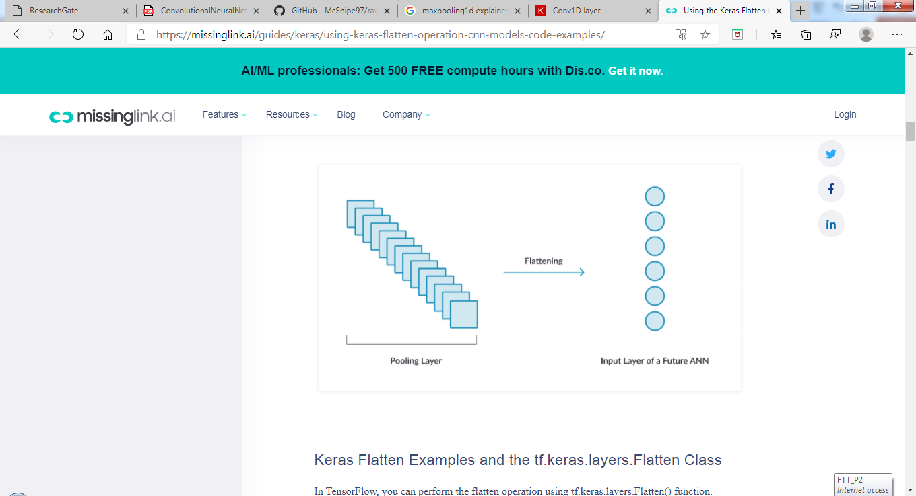
Flatten
Flattening is converting the data into a 1-dimensional array for inputting it to the next layer.
We flatten the output of the convolutional layers to create a single long feature vector. And it is connected to the final classification model, which is called a fully-connected layer.

Slide 14
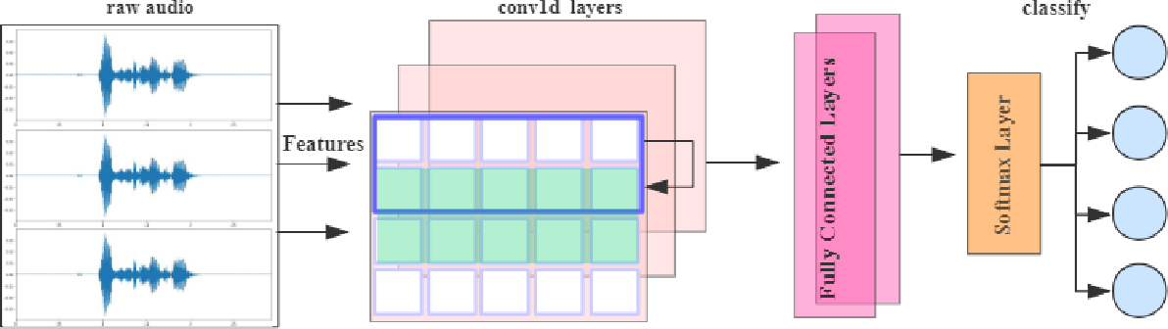
Fully Connected
Fully connected layers connect every neuron in one layer to every neuron in another layer.
After feature extraction we need to classify the data into various classes, this can be done using a fully connected (FC) neural network
Taking the inputs from the feature analysis and applies weights to predict the correct label.

Slide 15
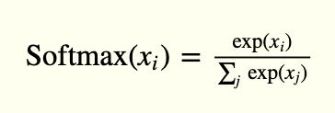
SoftMax:
SoftMax activation is normally applied to the very last layer in a neural net. The reason why SoftMax is useful is because it converts the output of the last layer in your neural network into what is essentially a probability distribution.

Slide 16
Model summary
Layer(type) | Output Shape | Param
Conv1 | (None, 40, 64) | 384
RuLU | (None, 40, 64) | 0
dropout | (None, 40, 64) | 0
Maxpooling1 | (None, 10, 64) | 0
Conv2 | (None, 10, 128) | 41088
RuLU | (None, 10, 128) | 0
dropout | (None, 10, 128) | 0
Maxpooling2 | (None, 2, 128) | 0
Conv3 | (None, 2, 256) | 164096
RuLU | (None, 2, 256) | 0
Dropout | (None, 2, 256) | 0
Flatten | (None, 512) | 0
FullyConnected | (None, 8) | 4104
softmax | (None, 8) | 0
Total params = 209672

Slide 17
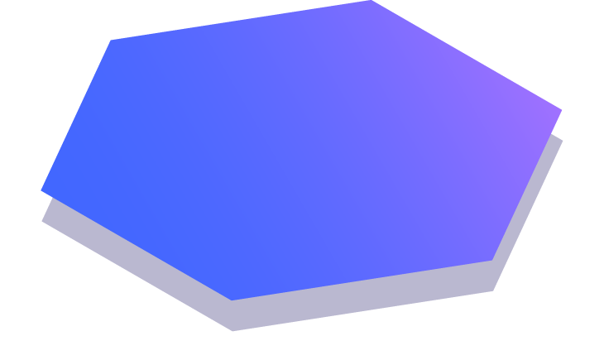
Train the model
It takes some time to train the model. After training, we save the weights and the model architecture.
Random initialization weights.
Categorical cross entropy loss function.
opt optimizer.
The learning rate is 0.00005
Mini batch size is 16.
Number of epochs are 200.

Slide 18
The Loss function
The loss function is the function that computes the distance between the current output of the algorithm and the expected output. It’s a method to evaluate how your algorithm models the data. It can be categorized into two groups. One for classification (discrete values, 0,1,2…) and the other for regression (continuous values).

Slide 19
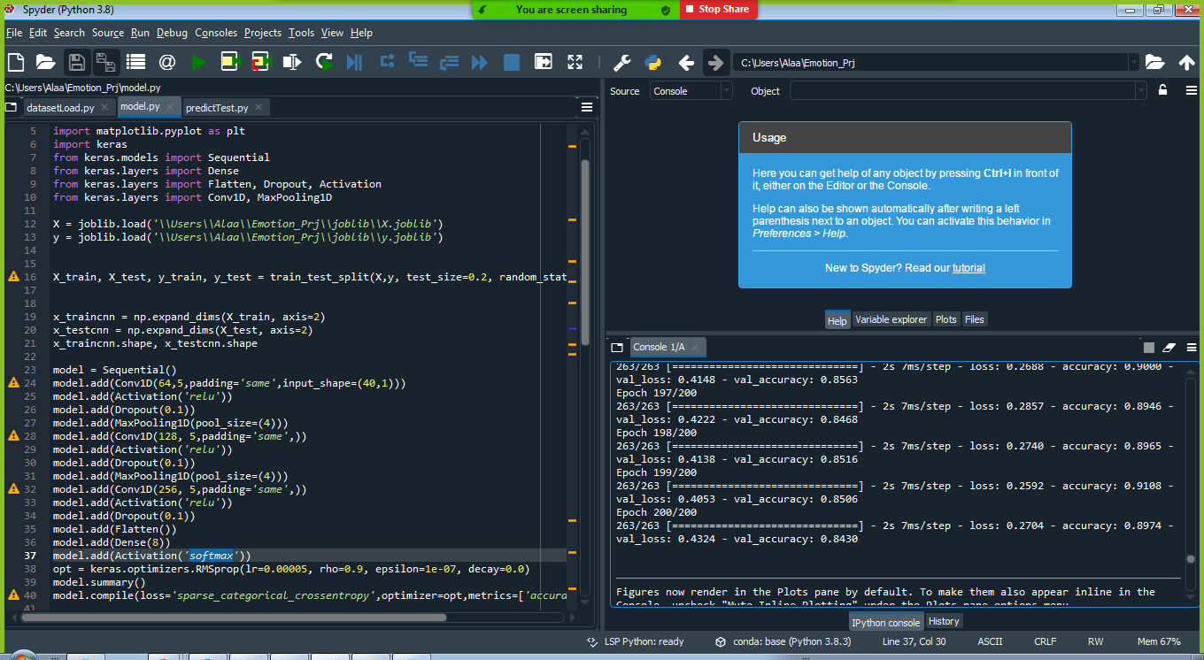
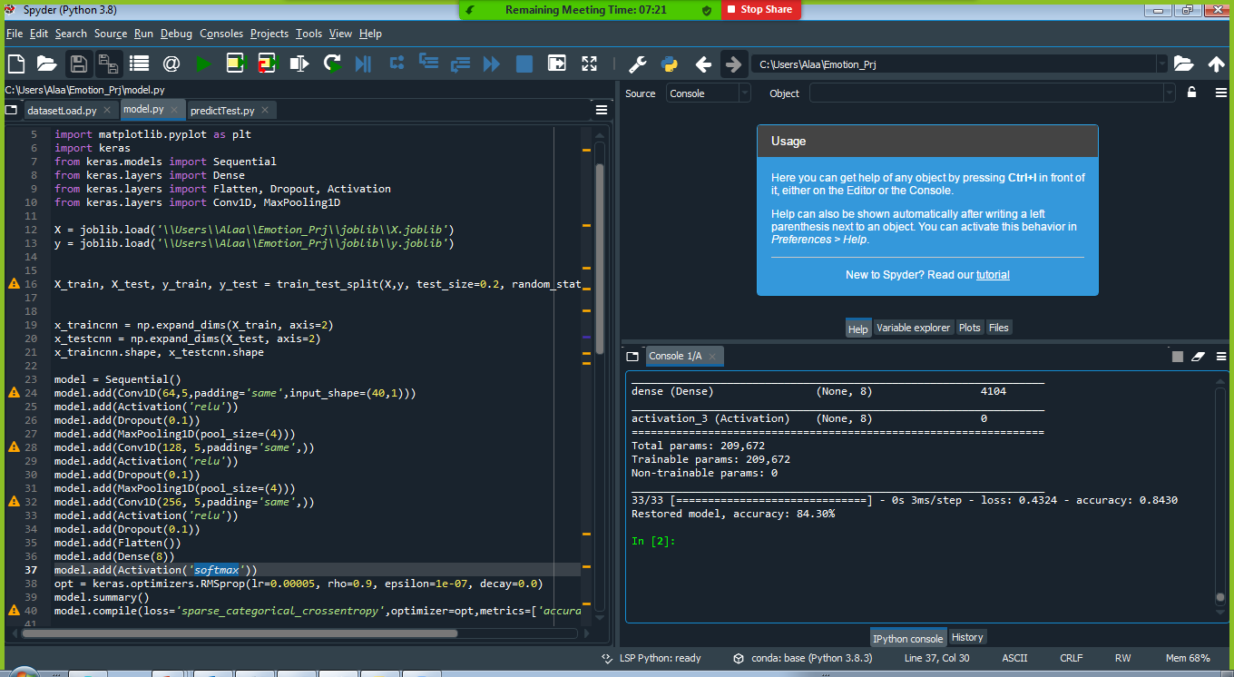
Evaluating the model
We have 2452 sound of Ravdess dataset and 2800 sound of TESS dataset, which will be used to evaluate how good our model works. The testing data was not involved in the training of the data therefore, it is new data for our model. The Ravdess and TESS dataset are well balanced so we can get around 84.30% accuracy.

Slide 20
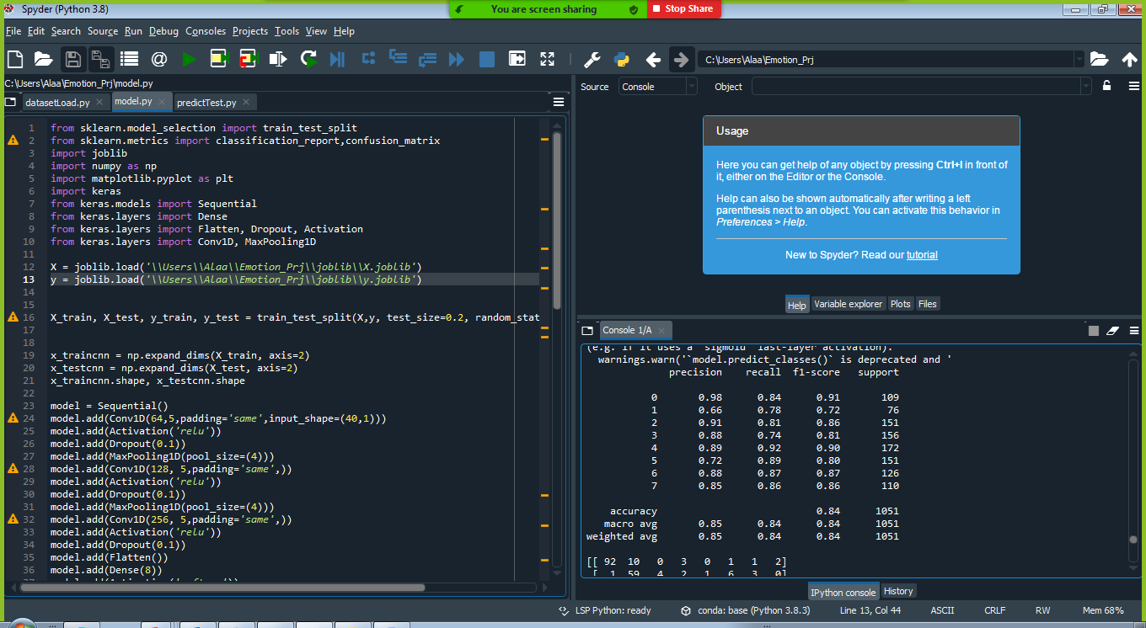
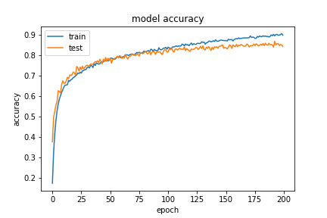
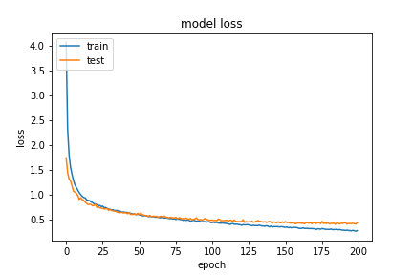
Results Achieved

Slide 21


Results:
Test a sound (click on the speaker to lasting)
Result :

Slide 22

Conclusions
Approaches based on deep neural networks are an excellent basis for solving the task.
Model is general enough to work in a real application context correctly
Combining the two datasets, RAVDESS & TESS, increased accuracy
Further Improvement: More data can be collected to increase model accuracy and performance on all emotion classes. Can improve the model further by predicting emotions on real time data. Also can incorporate other learning mechanisms to compute the percentage of emotions for audio with mixed emotion.

Slide 23

Thank you for listining
😉
😂😉😋😒😭

